Slide 1
INF10025
Data Management and Analytics
Week 01 – Part 2
MS Access, Table, Record, Field,
Primary Key

Slide 2
Data Basics in MS Access
Overview | Tables | Datasheets | Rows/Records | Columns/Fields | Properties | Primary Keys | Autonumber |

Slide 3
Microsoft Access
Access is a complete RDBMS
It is mainly used by individuals or small organisations
It is a good learning tool for students
Access requires MS Windows
  Mac Users can run MS Access using VirtualBox, Apps on Demand -Citrix (see Canvas→Modules→Unit Information).
Access is installed on all on-campus PCs

Slide 4
Multi-users, Sharing and Access
Access users typically do not create a database server
They usually do not share data with other users (unlike most business database users).
Swinburne labs do not easily allow students to share databases with other users.
So you will be creating single user databases in labs ☺
You will experience using data in a multi user environment in other units in your course

Slide 5
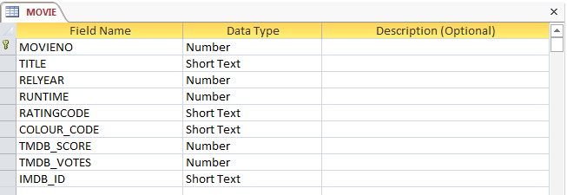
Table Design and Definition
The design view of a table shows details about all fields in a table
Each field has a data type (defines what type of data is allowed to be stored in this field)
We will concentrate on Short Text, Number, Currency & Date this semester
The symbol indicates this field is a Primary Key
In this example, movies are uniquely identified by MOVIENO:

Slide 6
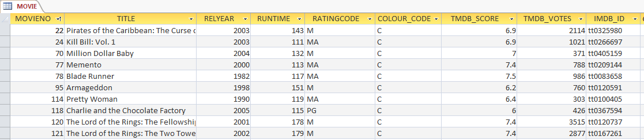
Datasheet View
The datasheet view of a table shows rows in a table
Not all rows can be loaded at once. If a table contained millions of rows, this would not be possible
The datasheet view is dangerous. If you change the contents of a cell and move to a new row, the data is changed permanently. There is no question asking "Do you want to save changes"!

Slide 7
Records/Fields vs. Rows/Columns
Most databases & DB developers use the term Row rather than Record
  Access uses the term Record.
  Oracle (which we will use later) uses the term Row
  We will use them interchangeably during the semester
Most databases & DB developers use the term Column rather than Field
  Access uses the term Field.
  Oracle uses the term Column
  We will use them interchangeably during the semester

Slide 8
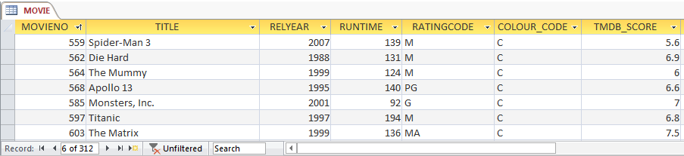
Access Fields and Records
The movie table contains 312 records
Each record contains data about one movie
Each record is made up of many fields.
Table Name
A field
A record

Slide 9
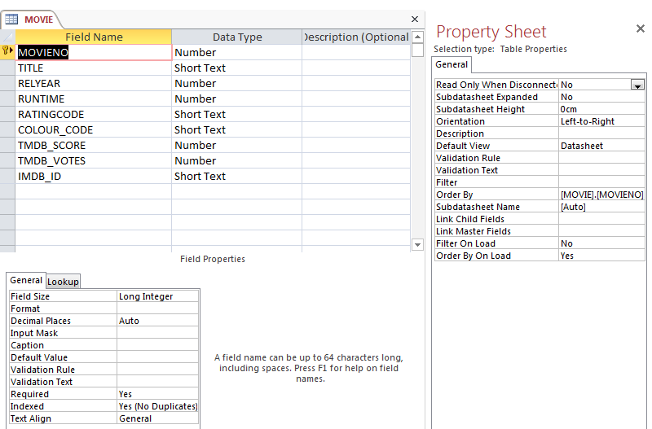
Field Properties and Property Sheet
As you use the Design view of a table, you may see
  The Property Sheet
  Field Properties
Don't be overwhelmed.
This semester, we will
ignore almost all of these settings

Slide 10
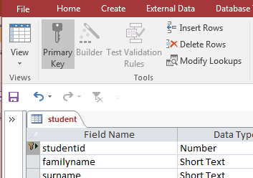
Primary Keys
Every table that you create must have a Primary Key.
While this is optional within Access, any table based on Codd's Relational Model must have a Primary Key.
A Primary Key is a field which will
contain a value that is a unique identifier
for each record
No duplicates are permitted.
The data should be static. It should be
a value that should never need to change.
Select a field and then Click the icon

Slide 11
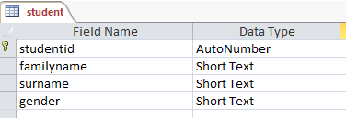
AutoNumber
If you create a table and forget to nominate a Primary Key, Access will ask if you want it to create one for you
Such a key will have a AutoNumber datatype
In such cases, the user would never have to enter a new student number for each student.
Instead Access will simply allocate a sequential numbered value
This is a very useful mechanism
However, avoid using AutoNumber datatypes
for the first weeks of the semester.

